Slide 1
containers
Taught by Yossef Ayman Zedan

Slide 2
What are the containers?
Containers are the classes that the content of the web type inside in order to give it some space from left and right to prevent x-axis scrolling.
In the pure HTML5, we type the content inside <main></main> For an example.
In bootstrap, we can type it inside <div class=“container”></div>
And we have container, container-sm, md, lg, xl, xxl, fluid

Slide 3
What is the difference between container, container-sm, md, lg, xl, xxl, fluid
Container small occupies 100% of the screen when the width of the screen is smaller than 567px.
Container medium occupies 100% of the screen when the width of the screen is smaller than 768px.
Container large occupies 100% of the screen when the width of the screen is smaller than 992px.
Container X-large occupies 100% of the screen when the width of the screen is smaller than 1200px.
Container XX-large occupies 100% of the screen when the width of the screen is smaller than 1400px.

Slide 4
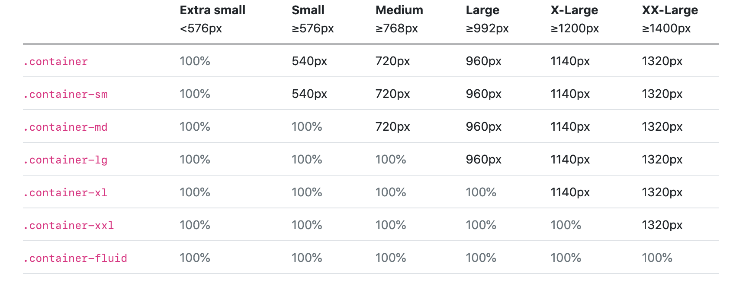
The complete guide for the width of the screen with each container

Slide 5
Just Container
The container class is the same as container-sm, it occupies 100% when the screen width is smaller than 567px.

Slide 6
Container fluid
Container fluid always occupies 100% of the screen but there is a question.. Why should i use it instead of just moving on without it ?
Some components inside the webpage can occupy more than 100% of the screen and there is nothing inside the CSS that means that I can’t exceed the 100% of the page..
This might cause In x-axis scrolling

Slide 7
Containers in Sass
$container-max-widths: (
sm: 540px,
md: 720px,
lg: 960px,
xl: 1140px,
xxl: 1320px
);

